Slide 1

Game Theory Eight
Continuous Strategies
Jacob Wyngaard

Slide 2
Last Discussion
Construction of Ordinal Potentials
Preference Arrows
Player 1 Preference
Player 2 Preference
Iteratively:
Select a box with all arrows pointing outward
Label the box with the next number (start at 0)
Remove all outgoing arrows associated with that box
Similar to physics, we use gradients to uncover the underlying potential

Slide 3
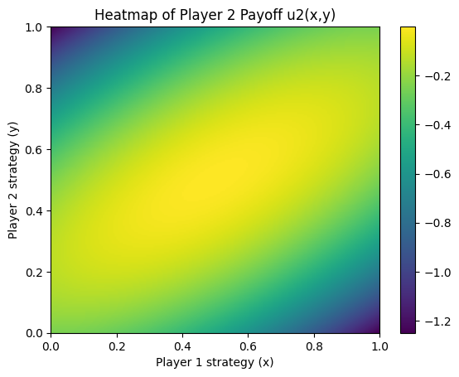
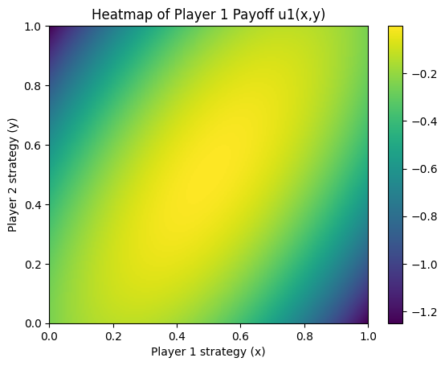
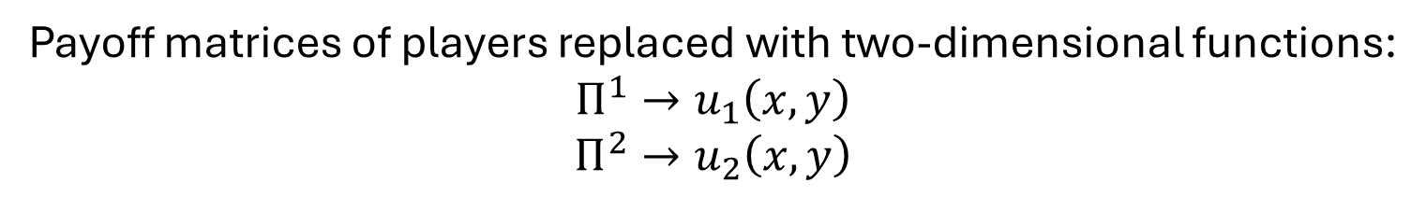


Extension to Continuous Strategies
Payoff matrices of players replaced with two-dimensional functions:
$$Π^{1}→u_{1}\left(x,y\right)$$
$Π^{2}→u_{2}\left(x,y\right)$
Example:
$$u_{1}\left(x,y\right)=−{\left(x−\frac{1}{2}\right)}^{2}−{\left(x−y\right)}^{2}$$
$$u_{2}\left(x,y\right)=−{\left(y−\frac{1}{2}\right)}^{2}−{\left(x−y\right)}^{2}$$
For this extension, $x$ and $y$ represent strategies, not probabilities

Slide 4
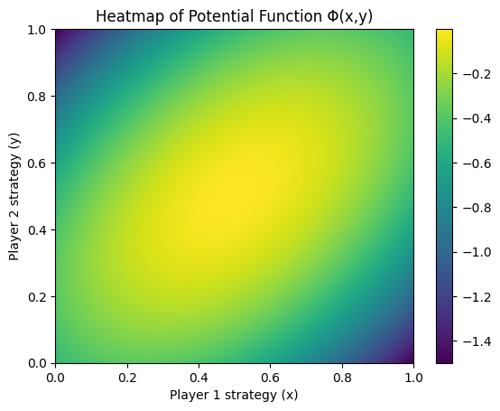
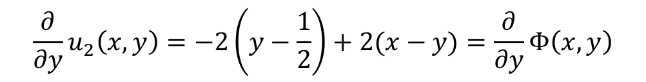
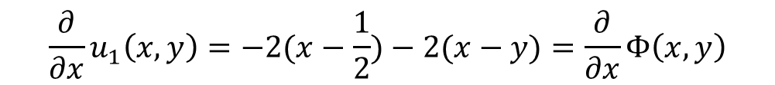
Extension to Continuous Strategies
In this case, our ordinal potential is $Φ\left(x,y\right)=−{\left(x−\frac{1}{2}\right)}^{2}−{\left(y−\frac{1}{2}\right)}^{2}−{\left(x−y\right)}^{2}$
Our ordinal potential preserves user preferences regarding their strategy
$${\frac{∂}{∂x}u}_{1}\left(x,y\right)=−2(x−\frac{1}{2})−2(x−y)=\frac{∂}{∂x}Φ\left(x,y\right)$$
$${\frac{∂}{∂y}u}_{2}\left(x,y\right)=−2\left(y−\frac{1}{2}\right)+2(x−y)=\frac{∂}{∂y}Φ\left(x,y\right)$$

Slide 5
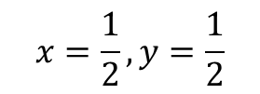
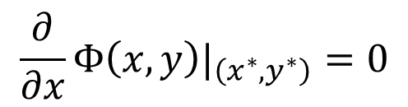
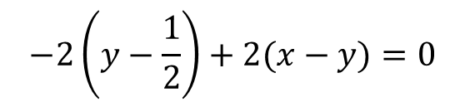
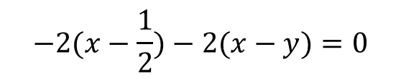
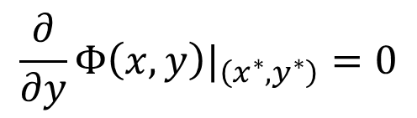
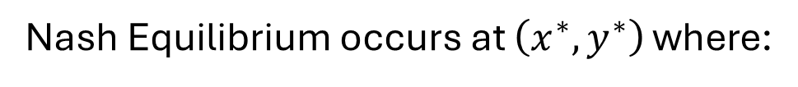
Extension to Continuous Strategies
Nash Equilibrium occurs at $\left(x^{∗},y^{∗}\right)$ where:
$$\frac{∂}{∂x}Φ\left(x,y\right)|_{\left(x^{∗},y^{∗}\right)}=0$$
Player 1 doesn’t benefit by changing their strategy
$$\frac{∂}{∂y}Φ\left(x,y\right)|_{\left(x^{∗},y^{∗}\right)}=0$$
Player 2 doesn’t benefit by changing their strategy
In the example, this corresponds to:
$$−2(x−\frac{1}{2})−2(x−y)=0$$
$$x=\frac{1}{2},y=\frac{1}{2}$$
$$−2\left(y−\frac{1}{2}\right)+2(x−y)=0$$

Slide 6
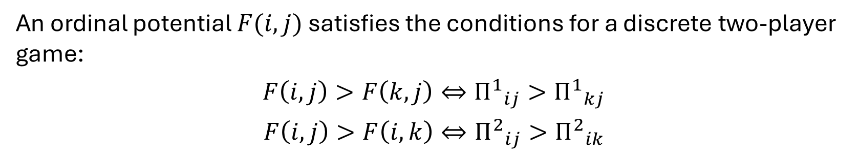
Existence of Nash Equilibrium
An ordinal potential $F(i,j)$ satisfies the conditions for a discrete two-player game:
$$F\left(i,j\right)>F\left(k,j\right)⇔{Π^{1}}_{ij}>{Π^{1}}_{kj}$$
$$F\left(i,j\right)>F\left(i,k\right)⇔{Π^{2}}_{ij}>{Π^{2}}_{ik}$$
If an ordinal potential exists for a finite game, then that game possesses a pure-strategy Nash Equilibrium [Monderer and Shapley, 2010]

Slide 7
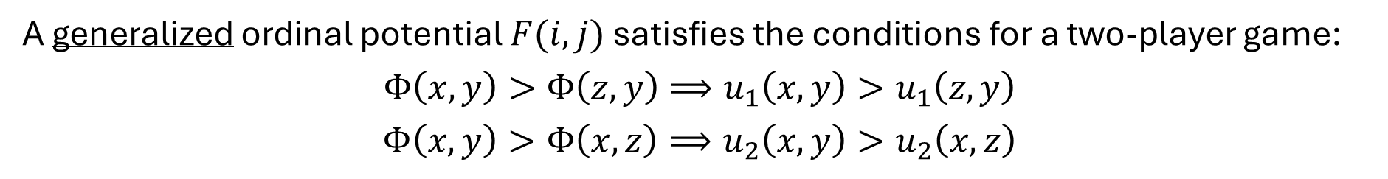
Existence of Nash Equilibrium
A generalized ordinal potential $F(i,j)$ satisfies the conditions for a two-player game:
$$Φ\left(x,y\right)>Φ\left(z,y\right)⟹u_{1}\left(x,y\right)>u_{1}\left(z,y\right)$$
$$Φ\left(x,y\right)>Φ\left(x,z\right)⟹u_{2}\left(x,y\right)>u_{2}\left(x,z\right)$$
If a generalized ordinal potential exists for a game with compact strategy sets, then that game possesses a Nash Equilibrium [Kukushkin, 2010]

Slide 8


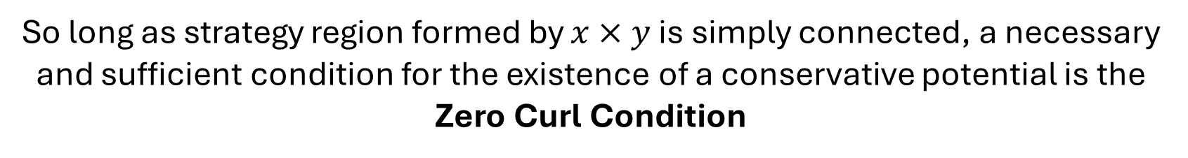
Relation to Conservative Potentials
The existence of an ordinal potential is equivalent to the existence of a conservative potential for the following vector field:
$$( \frac{∂}{∂x}u_{1}\left(x,y\right),\frac{∂}{∂y}u_{2}\left(x,y\right) )$$
So long as strategy region formed by $x×y$ is simply connected, a necessary and sufficient condition for the existence of a conservative potential is the Zero Curl Condition
$$\frac{∂}{∂y}\frac{∂}{∂x}u_{1}\left(x,y\right)=\frac{∂}{∂x}\frac{∂}{∂y}u_{2}\left(x,y\right)$$

Slide 9

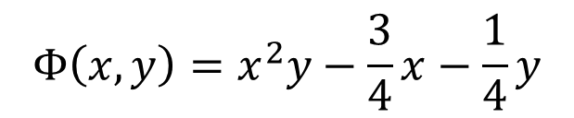
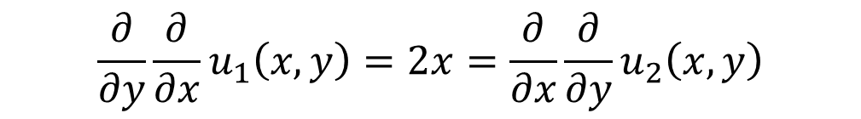
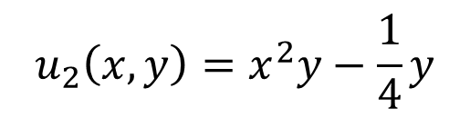
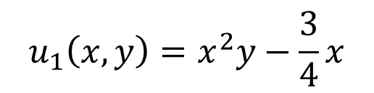
Determining If An Ordinal Potential Exists
Example:
Consider a two-player continuous strategy game with
$$u_{1}\left(x,y\right)=x^{2}y−\frac{3}{4}x$$
$$u_{2}\left(x,y\right)=x^{2}y−\frac{1}{4}y$$
$$\frac{∂}{∂y}\frac{∂}{∂x}u_{1}\left(x,y\right)=2x=\frac{∂}{∂x}\frac{∂}{∂y}u_{2}\left(x,y\right)$$
Zero Curl Condition
Our Ordinal Potential is the sum of $u_{1}\left(x,y\right)$ and $u_{1}\left(x,y\right)$ without repeating terms:
$$Φ\left(x,y\right)=x^{2}y−\frac{3}{4}x−\frac{1}{4}y$$

Slide 10
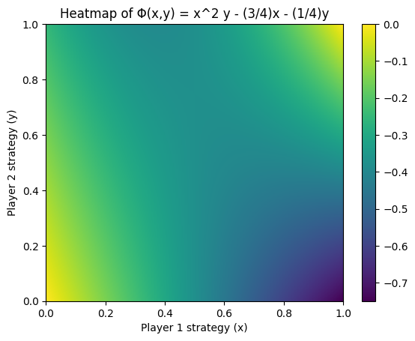
Determining If An Ordinal Potential Exists
Example:
A Nash Equilibrium is at $\left(x^{∗},y^{∗}\right)=(\frac{1}{2},\frac{3}{4})$

Slide 11
Discrete Zero Curl Condition
Player 2
Player 2
A
B
C
A
B
C
1
5 | 2 | 4
1 | 4 | 2
3 | 1 | 3
1
4 | 1 | 3
2 | 5 | 1
1 | 2 | 4
Player 1
Player 1
2
2
3
3
-3 | 2
3 | -4
1 | 2
-4 | 2 | -2
2 | -3 | 1

Slide 12
Discrete Zero Curl Condition
-4 | 2 | -2
2 | -3 | 1
-3 | 2
3 | -4
1 | 2
6 | -4
-5 | 4
6 | -6
-2 | 6
Same preferences between orthogonally adjacent squares

Slide 13
Discrete Zero Curl Condition
Player 2
Player 2
A
B
C
A
B
C
1
2 | 1 | 3
3 | 2 | 1
1 | 3 | 2
1
2 | 3 | 1
1 | 2 | 3
3 | 1 | 2
Player 1
Player 1
2
2
3
3
1 | -2
1 | 1
-2 | 1
1 | 1 | -2
-2 | 1 | 1

Slide 14
Discrete Zero Curl Condition
1 | 1 | -2
-2 | 1 | 1
1 | -2
1 | 1
-2 | 1
0 | -3
3 | 0
0 | 3
-3 | 0
Different preferences between orthogonally adjacent squares

Slide 15
More Examples

Slide 16
Discrete Zero Curl Condition
Player 2
Player 2
A
B
C
A
B
C
1
3 | 1 | 0
2 | 4 | 1
0 | 2 | 5
1
3 | 2 | 0
1 | 4 | 2
0 | 1 | 5
Player 1
Player 1
2
2
3
3
-1 | -2
3 | -2
1 | 4
-1 | 3 | 1
-2 | -2 | 4

Slide 17
Discrete Zero Curl Condition
-1 | -2
3 | -2
1 | 4
-1 | 3 | 1
-2 | -2 | 4
4 | -2
0 | 6
4 | 0
-2 | 6
Same preferences between orthogonally adjacent squares

Slide 18
Discrete Zero Curl Condition
Player 2
Player 2
A
B
C
A
B
C
1
3 | 1 | 2
2 | 3 | 1
1 | 2 | 3
1
1 | 3 | 2
2 | 1 | 3
3 | 2 | 1
Player 1
Player 1
2
2
3
3
2 | -1
-1 | 2
-1 | -2
-1 | 2 | -1
-1 | -1 | 2

Slide 19
Discrete Zero Curl Condition
2 | -1
-1 | 2
-1 | -2
-1 | 2 | -1
-1 | -1 | 2
3 | -3
0 | 3
-3 | 3
0 | -4
Different preferences between orthogonally adjacent squares

